Slide 1
User Preference-aware Fake News Detection
Yingtong Dou, Kai Shu, Congying Xia, Philip S. Yu, Lichao Sun
Department of Computer Science, University of Illinois at Chicago, Chicago, IL, USA
Department of Computer Science, Illinois Institute of Technology, Chicago, IL, USA
Department of Computer Science and Engineering, Lehigh University, Bethlehem, PA, USA
Zhuomin Chen
2021.07.06
SIGIR ’21, July 11–15, 2021, Virtual Event, Canada

Slide 2
Introduction
The majority of existing fake news detection algorithms:
Focus on mining news content and/or the surrounding exogenous context.
Ignored:
The endogenous preference of a user when he/she decides to spread a piece of fake news or not.

Slide 3
Introduction
Naíve Realism : Consumers tend to believe that their perceptions of
reality are the only accurate views, while others who disagree are
regarded as uninformed, irrational, or biased.
Confirmation Bias theory: Consumers prefer to receive information
that confirms their existing views.

Slide 4
Introduction
User Preference-aware Fake Detection (UPFD).
Consider the historical posts of social media users as their endogenous preference in news consumption.

Slide 5
Our Approach

Slide 6
Endogenous Preference Encoding
Crawl the recent two hundred tweets for each account.
For inaccessible users whose accounts are suspended or deleted, we use randomly sampled tweets from accessible users engaging the same news as its corresponding historical posts.

Slide 7
Endogenous Preference Encoding
Two types of text representation learning approaches:
1. Word2vec: Average the vectors of existing words in combined recent 200 tweets to get user preference representation.
2. BERT: Encode each tweet separately and average them afterward to obtain a user’s preference representation.

Slide 8
Exogenous Context Extraction
A new piece:
A list of users that retweeted ordered by time:

Slide 9
Exogenous Context Extraction
Rules:
For any account , if retweets the same news later than at least one following accounts in , we estimate the news spreads from the account with the latest timestamp to account .
If account does not follow any accounts in the retweet sequences including the source account, we conservatively estimate the news spreads from the accounts with the most number of followers.

Slide 10
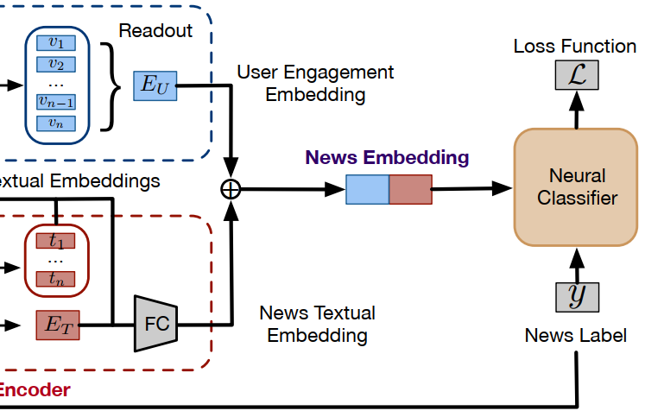
Information Fusion
Readout function: Mean pooling operation
Neural classifier: A two-layer Multilayer Perceptron (MLP)

Slide 11
Experiment

Slide 12
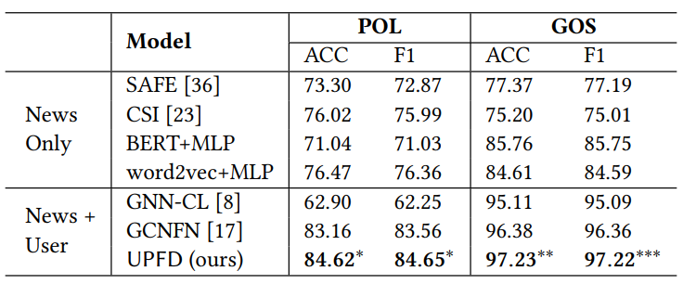
Experiment

Slide 13
Experiment
The endogenous features : Word2vec and BERT.
GraphSAGE : Learn node embeddings via aggregating neighbor nodes information.
GCNFN : Leverage two GCN layers to encode the news propagation graph.

Slide 14
Experiment
The UPFD variant without exogenous information (-EXO)
The UPFD variant without endogenous information(-END)

